Slide 1
The Use of international sanctions and why?

Slide 2
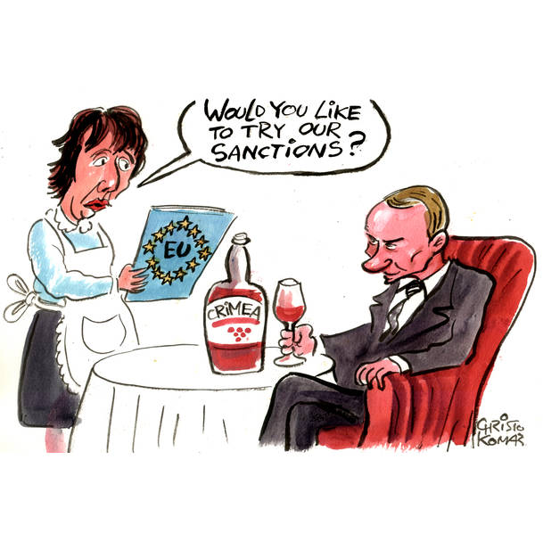
SANCTIONS
Sanctions are mainly imposed in order to bring about change or pressure on a country or Government without the use of armed force such as :
to signal disapproval of behaviour on a state;
to maintain neutrality in an ongoing conflict; or
to limit the ability of a state to inflict violence on others by weakening country's military capabilities, amongst others.

Slide 3
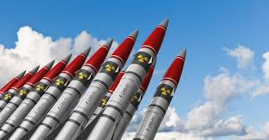
The Use of Sanctions
To reduce a State’s ability to use violence against another State or against its own people
To freeze assets believed to have been misappropriated from the State.
To prevent a country from having the funds to purchase weapons of mass destruction.
To prevent terrorist organisations or terrorist individuals from amassing funding to be use in acts of terror.

Slide 4
SANCTIONS
UN Sanctions Regimes
Afghanistan, Central African Republic, Democratic Republic of Congo, Guinea-Bisseau, Iran, Iraq, Lebanon, Libya, Mali, North Korea, Somalia, South Sudan, Sudan, and Yemen.
Sanctions regimes imposed only by the EU
Belarus, Bosnia and Herzegovina, Burundi, China, Egypt, Guinea, Haiti, Maldives, Moldova, Montenegro, Myanmar/Burma, Russia, Nicaragua, Serbia, Syria, Tunisia, Turkey, Ukraine, United States, Venezuela and Zimbabwe.
Horizontal Regimes imposed by the UN/EU: Chemical Weapons Regime, Cyberattacks, Terrorism and Human Rights.

Slide 5
SANCTIONS
EU Sanctions Map https://www.sanctionsmap.eu/#/main
Consolidated lists are available online:
UN sanctions https://www.un.org/sc/suborg/en/sanctions/un-sc-consolidated-list
EU Sanctions
https://eeas.europa.eu/topics/common-foreign-security-policy-cfsp/8442/consolidated-list-sanctions_en
Press Releases.
National Sanctions – https://foreignaffairs.gov.mt/smb

Slide 6
Sanctions regimes of other countries

Slide 7
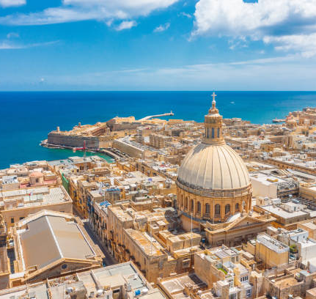
Malta’s Risks
Geographical Position
Proximity to sanctioned countries
Sizeable Company Registry and Shipping Registries
Financial services sector
A considerable foreign population

Slide 8
Malta’s Risks
Items withheld by Customs in recent years of possible sanctions concern:
Fittings and stainless steel sheets, Graphite, Base Oil, Barium Chloride, Aluminium billets, Arms, Rhibs, military truck engines.
Other seizures: outboard and inboard motors, tramadol, telecommunication equipment and Libyan dinars.

Slide 9
SANCTIONS National Interest (Enabling Powers) Act
The 2018 amendments to the National Interest (Enabling Powers) Act had a pivotal role in transforming the local law on sanctions:
Provides for the direct applicability of UN/EU sanctions and national sanctions.
Increases the penalties for breaches of sanctions.
Establishes a clear procedure concerning the freezing of assets.
Provides for the forfeiture of goods found to be in breach of sanctions.
Places an obligation on subject persons to have systems in place.

Slide 10
The Sanctions Monitoring Board
The National Interest (Enabling Powers) Act sets which is composed of 18 different authorities :
Ministry for Foreign and European Affairs - Attorney General -Commissioner of Police- Office of the Prime Minister – FIAU – Malta Security Services – Ministry for Home Affairs, National Security and Law Enforcement- Director Defence – Ministry for Finance and Financial Services- Ministry for the Economy, Investment and Small Business- Department of Trade- Malta Customs-Central Bank- MFSA- Maritime Affairs- Aviation- Lands- Immigration.

Slide 11
The Work of the SMB
The SMB gives decisions on sanctions related issues.
Authorises access to frozen funds.
Issues penalties to subject persons for failing to have systems in place.
Most Common sanctions Regimes: Russia, Libya, Iran, Sudan and Syria
Who contacts the SMB : Banks/FIs, Businesses, Exporters, Shipping Companies, Government entities.
Most Common Issues-
Russia – ownership and control, financial transactions.
Libyan frozen assets;
ownership and control; decision on whether goods/software/ provision of services are in accordance to sanctions.

Slide 12
National Interest (Enabling Powers) Act- Penalties for breach of Sanctions
Article 6 (1), (2)
Imprisonment increased from a minimum of twelve (12) months to a maximum of twelve (12) years; and/or
A fine of not less than twenty-five thousand euros (€25,000) and not exceeding five million euros (€5,000,000), for individuals; and a fine of not less than eighty thousand euros (€80,000) and not exceeding ten million euros (€10,000,000) for corporations.
an offending body corporate may be subject to the suspension or cancellation of a licence; temporary or permanent closure of the establishment; compulsory winding up of the body corporate; and exclusion from entitlement to public benefits or aid.
Forfeiture of the goods in violation of sanctions.

Slide 13
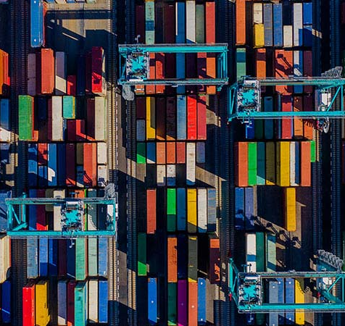
Characteristics of a Sanctions Regime
Most sanctions regimes are made up of :
Asset Freezes/ Travel Bans
Definition of property.
Direct or indirect ownership or control.
Restrictions on goods/services
e.g. military items, dual use goods, goods used for a particular industry; transportation, provision of insurance

Slide 14
Countries subject to an Arms Embargo
UN Sanctions Regimes
Afghanistan, Central African Republic, Democratic Republic of Congo, Guinea-Bisseau, Iran, Iraq, Lebanon, Libya, Mali, North Korea, Somalia, South Sudan, Sudan, and Yemen.
Sanctions regimes imposed only by the EU
Belarus, Bosnia and Herzegovina, Burundi, China, Egypt, Guinea, Haiti, Maldives, Moldova, Montenegro, Myanmar/Burma, Russia, Nicaragua, Serbia, Syria, Tunisia, Turkey, Ukraine, United States, Venezuela and Zimbabwe.

Slide 15
Main Components of Sanctions Regimes Restrictions on goods/services
Goods used for internal repression.
Dual use goods: goods that are normally used for civilian purposes but which may have a military application or that can be used for a nuclear weapons programme.
Goods related to a particular industry: e.g. equipment intended for the oil industry, telecommunications monitoring equipment; certain types of software.
Restrictions on services: can include restrictions on the provision of insurance, services in relation to the oil industry, brokering restrictions on use of means of transport, restrictions on access to capital markets and the provision of financial services; restrictions on use of ports and tourism.

Slide 16
Dual Use Goods
Goods designed for civil use but which can be used for military purposes such as certain materials, machine tools, electronic equipment, computers, telecommunications equipment, cryptographic goods, sensors and radar, navigation and avionic equipment, marine equipment and space and propulsion.
Dual use goods are listed in Annex 1 to Council Regulation (EU) 2021/821​.
Exports of other goods to certain destinations may also be controlled if the country of destination is subject to UN, EU sanctions.
A licence is required for ll exports of Dual use Items
One may seek advice from the Trade Services Directorate providing all the relevant technical information and specifications of the products and details of the intended destinations.
An application for an export licence must be made electronically on commerce.gov.mt or servizz.gov.mt.

Slide 17
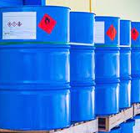
Dual Use Goods
If a licence is not obtained and the cargo is sent for export, The cargo/item could be intercepted by Customs who would withhold it until it is determined whether it is subject to licensing and exporter could be subject to the fines listed in article 15 of Subsidiary Legislation 365.12.
An authorization shall also be required for intra-Community transfers of dual-use items listed in Annex IV of the Council Regulation.

Slide 18
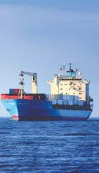
Sanctions and Vessels
Maritime transportation is essential to international trade but can also be used for the illicit carriage of goods i.e.
Goods that are prohibited from being exported or imported from a particular country
Ships entering ports which are subject to a port entry ban
Ships can be owned or controlled by a listed person or entity
Ships engage in various deceptive practices to avoid detection of sanctions violations
Ship to ship transfers
disabling or manipulating the Automatic Identification System (AIS),
physically altering vessel identification, falsifying cargo and vessel documents
demonstrating voyage irregularities, using false flags, flag hopping.
A state has jurisdiction over its flagged vessels for the prosecution of cases where a breach of sanctions has taken place, even when the sanctions violations has occurred on the High Seas. Many cases of sanctions violations have occurred through the use of vessels .

Slide 19
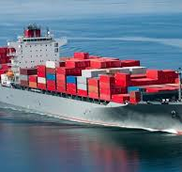
Specific Restrictions on Vessels
Inspections on Vessels upon information that the cargo contains prohibited items : Yemen, Somalia, Iran, Libya, DPRK
Libya: designated vessels: flag States, shall direct the vessel not to load, transport, or discharge crude oil illicitly exported from Libya. Financial transactions with respect to crude oil illicitly exported from Libya aboard designated vessels are also prohibited. Member States shall deny entry into their ports of designated vessels. Prohibited to provide bunkering and other services to designated vessels.
Russia: prohibition of entry into ports of Russian owned vessels

Slide 20
DPRK Vessels
It is prohibited to:
Obtain authorization for a vessel to use the DPRK flag.
Allow the entry into their ports of DPRK vessels.
To own, lease, operate, or provide any vessel classification, certification or associated service, or to insure any vessel flagged to the DPRK, including chartering such vessels. prohibited to provide any servicing to DPRK vessels.
A Member State that is a flag State of a vessel designated by the UN Sanctions Committee shall, if the Committee has so specified, de-flag the vessel or direct the vessel to an identified port.
Engage in ship-to-ship transfers to or from any DPRK flagged vessel of any goods that are being sold, supplied, transferred or exported to or from the DPRK.
Member States shall seize, inspect and impound any vessel in their ports, and may seize, inspect and impound any vessel subject to their jurisdiction in their territorial waters where there are reasonable grounds to believe that the vessel has been involved in activities, or the transport of items, prohibited by the relevant UN Security Council Resolutions.

Slide 21
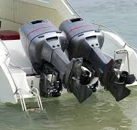
Goods that can be used for Human Trafficking
A prior authorization is required for the export to Libya re:
Outboard Motors for marine propulsion
Electrical outboard motors for marine propulsion
Inflatable vessels for pleasure or sport
Outboard motor boats
The competent authority concerned shall not grant authorization referred to in paragraph 1 when there are reasonable grounds to believe that the goods would be used for the purpose of smuggling of migrants and trafficking in human beings.

Slide 22
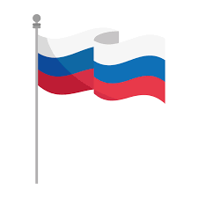
The Latest Restrictions on Russia
Financial Restrictions
Increase in the entities that are now subject to restriction on trading in transferable securities and money market instruments
Prohibition on the acceptance of any deposits from Russian nationals and residents or entities established in Russia, if the total value of deposits exceeds €100,000
Exclusion from SWIFT of main Russian Banks: Bank Otkritie, Novikombank, Promsvyazbank, Rossiya Bank, Sovcombank, Vnesheconombank (VEB), and VTB Bank or to any legal person entity or body established in Russia whose proprietary rights are directly or indirectly owned for more than 50% by an entity listed in annex XIV;
A ban on selling, supplying, transferring or exporting euro denominated bank notes to Russia;
A prohibition on all transactions with certain state-owned companies which are already subject to refinancing restrictions
A prohibition on being a beneficiary, acting as a trustee or in similar capacities for Russian persons and entities, as well as a prohibition on providing certain services to trusts;
Prohibition on deposits to crypto-wallets, accounts or custody services to Russian nationals or natural persons residing in Russia, or legal persons, entities or bodies established in Russia if the total value of crypto-assets of the natural or legal person, entity or body per wallet, account, or custody provider exceeds EUR 10,000;

Slide 23
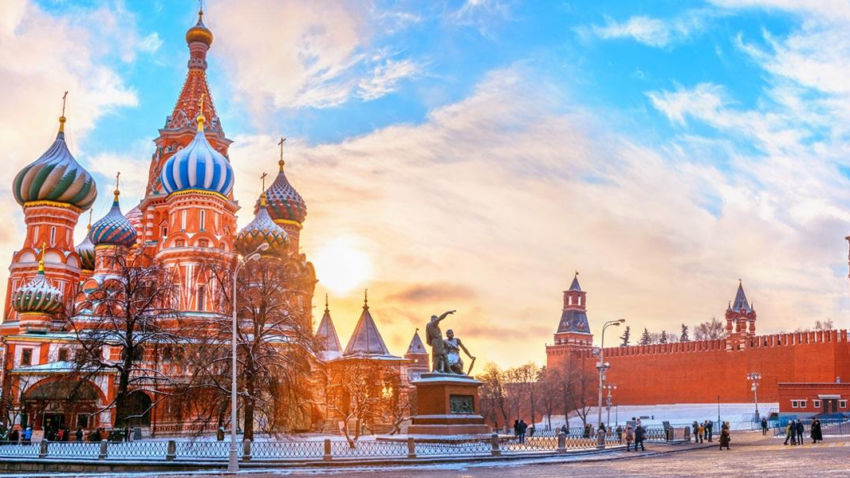
New Restrictions on Russia
Trade with Donetsk and Luhansk
The importation into the EU of goods originating in the Donetsk and Luhansk oblasts of Ukraine,; Dealing in real estate located in the Donetsk and Luhansk oblasts of Ukraine, ; The provision of services directly related to tourism activities in the Donetsk and Luhansk oblasts of Ukraine;
Technology Sector:
Advanced semiconductors, high-end electronics, software, sensitive machinery and transportation equipment.
Dual-use goods and technology listed in Annex I to Regulation (EU) 2021/821; and
Goods and technology which might contribute to Russia’s military and technological enhancement, or the development of the defence and security sector.
Quantum computers

Slide 24
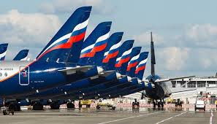
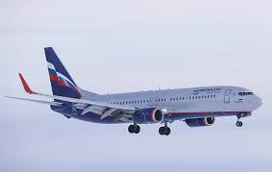
Transport
A flight ban on any aircraft operated by Russian air carriers, including as a marketing carrier in code sharing or blocked space arrangements, to any Russian registered aircraft, or to any non-Russian-registered aircraft which is owned or chartered, or otherwise controlled by any Russian person/entity, to land in, take off from, or overfly EU territory. The prohibition includes permission to land in, take off from or overfly the territory of the European Union.
A prohibition on any Russian and Belarusian road transport undertakings preventing them from transporting goods by road within the Union, including in transit.
Goods and technology suited for use in the aviation and space industry;
The export of maritime navigation goods directly or indirectly whether or not originating in the EU, to any natural person, entity or body in Russia, for use in Russia, or for the placing on board of a Russian-flagged vessel
Additional import restrictions on certain goods

Slide 25
Restrictions on Russia
Energy Sector
Prohibitions targeting new investments in the Russian energy sector, as well as a comprehensive export restriction on equipment, technology and services for the energy industry in Russia, with the exception of the nuclear industry and the downstream sector of energy transport.
Restrictions on coal and other solid fossil fuels importation from Russia into the EU.
The sale, supply transfer or export goods and technology listed in Annex II of Council Regulation 2022/263 which are related to the transport, telecommunications, energy sectors including the exploration and production of oil, gas and mineral resources.
Broadcasting
Any broadcasting by the legal persons, entities or bodies listed in Annex XV of Council Regulation 833/2014 is prohibited. This prohibition includes the transmission or distribution by any means such as cable, satellite, IP-TV, internet service providers, internet video-sharing platform or applications whether new or pre-installed.
Public Procurement and Contracts
A general prohibition on participation of Russian companies in public procurement in Member States .This forbids the award and continued execution of public contracts.
Other
Export bans to Russia on wood, cement, fertilisers, seafood, iron and steel products, luxury goods and liquor.

Slide 26
What Exporters need to look out for
Financial Transactions:
Who is sending the funds.
Who is receiving the funds.
The purpose of the funds.
Goods/Services:
Country of Provenance.
Country of destination.
End user and end use.

Slide 27
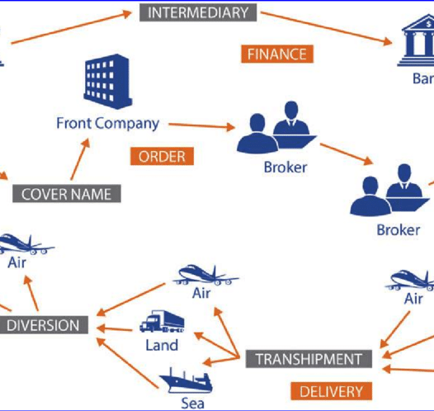
Difficulties in Identifying a sanctions related transaction
A growing trend in the purchase and sale of elementary components as opposed to whole manufactured systems which can also have legitimate uses (eg dual use goods);
The identification of dual use goods is difficult, requiring specialist knowledge and can be described in common terms eg ‘pumps’;
Complex networks used to procure sensitive goods often involving front companies, false end users and false documentation are often used.
May involve other actors with no immediate or obvious connection to individuals and entities designated in the sanctions lists and can be disconnected to the physical flow or proliferation-sensitive goods;
Transactions may occur within normal business pathways and can be masked with all legitimate transactions.

Slide 28
Administrative fines
Obligations under article 17(6) of the National Interest (Enabling Powers) Act
(6) Any legal or natural person conducting a relevant activity or relevant financial business as defined in the Prevention of Money Laundering and Funding of Terrorism Regulations shall be required to:
(a) regularly check the list of designations by the United Nations, the European Union, and the Board, and to screen their client databases against those lists on a regular basis and immediately after a change to any of these lists occurs;
(b) have in place and effectively implement internal controls and procedures to ensure compliance with the obligations arising from this Act and any relevant United Nations or European Union Resolutions or regulations; and
(c) immediately notify the Board in case targeted property is identified, and of the actions taken in relation to such property in compliance with the requirements under this

Slide 29
What can we do?
Be vigilant.
Know your sanctions
View transactions with the perspective of sanctions in mind.
Red flags?
Know your customer.
Use screening tools if your risks are high.
Be aware of adverse media
Report your suspicions to the Sanctions Monitoring Board.

Slide 30
The Sanctions Monitoring Board may be contacted on sanctions.mfea@gov.mt

