Slide 1
The CEF eTranslation platform @ work
Mark Vella
Language Officer
European Commission Representation in Malta mark.vella@ec.europa.eu
1

Slide 2
CEF eTranslation
The aim of CEF eTranslation is to enable European and national public administrations to share information beyond language barriers.
Notes:
eTranslation is a branch of Connecting Europe Facility.It provides machine translation capabilities that allow Digital Service Infrastructures (DSIs) to be multilingual.

Slide 3
How the system works
The system is trained by large translation memories, with over one billion sentences in 24 official EU languages produced by translators of the EU institutions over the years.
Other data is also collected to be inserted into this repository.
Move from statistical to neural translation
Notes:
They are in fact particularly suitable for documents of the type of EU policy documents.

Slide 4
eTranslation platform at a glance
eTranslation
CEF.AT
MT@EC
Legalese
Statistical machine translation (Moses)
Domain adaptation
Improved web interface
Integration with online public services
Cloud based
Neural engines
More NLP tools (transliteration, named entity recognition etc.)
Generic services
2
4

Slide 5
System characteristics (1)
Available in the 24 official languages of the EU, Icelandic and Norwegian (Bokmål), together with increased capacity for global languages such as Russian, Chinese, Turkish, Japanese, Arabic, and now also Ukranian.
You can translate more than one document in the same operation
Accepts a wide variety of document formats
All formatting is maintained (except for pdf)

Slide 6
System characteristics (2)
Language is automatically recognisable for text snippets of more than 30 characters
The translation will be sent to your email address or placed in a personal space

Slide 7
ELRC Workshop, Malta, 1 November 2019
7

Slide 8
ELRC Workshop, Malta, 1 November 2019
8

Slide 9
Submit your document…
ELRC Workshop, Malta, 1 November 2019
9

Slide 10
Get your translation back by e-mail.
ELRC Workshop, Malta, 1 November 2019
10

Slide 11
One original, many translations…
ELRC Workshop, Malta, 1 November 2019
11

Slide 12
Many documents at once…
ELRC Workshop, Malta, 1 November 2019
12

Slide 13
ELRC Workshop, Malta, 1 November 2019
10

Slide 14
ELRC Workshop, Malta, 1 November 2019

Slide 15
Integration of eTranslation Recommendations
Human translation for static content, e.g. menus, language policy etc.
Pre-translation with eTranslation for dynamic content, e.g. news articles (possibly replaced by human translation later)
On-the-fly translation with eTranslation only for input fields, newly generated text etc.
Make users knowingly request MT to avoid confusion
Add disclaimer
ELRC Workshop, Malta, 1 November 2019
20
20

Slide 16
Integration of eTranslation European Committee of the Regions
11/8/2019
ELRC Workshop, Malta, 1 November 2019
12

Slide 17
Integration of eTranslation European Committee of the Regions
11/8/2019
ELRC Workshop, Malta, 1 November 2019
13

Slide 18
Integration of eTranslation European Committee of the Regions
11/8/2019
ELRC Workshop, Malta, 1 November 2019
14

Slide 19
Integration of eTranslation European Committee of the Regions
11/8/2019
ELRC Workshop, Malta, 1 November 2019
15

Slide 20
Integration of eTranslation European Committee of the Regions
11/8/2019
ELRC Workshop, Malta, 1 November 2019
16

Slide 21
Integration of eTranslation European Committee of the Regions
11/8/2019
ELRC Workshop, Malta, 1 November 2019
17

Slide 22
Integration of eTranslation European Committee of the Regions
11/8/2019
ELRC Workshop, Malta, 1 November 2019
19

Slide 23
Benefits...
A system that uses correct terminology and style for different contexts
The system guarantees a continuous high quality service while maintaining confidentiality and data security during the translation process
Enables the exchange of information and access to online content and services in different countries in any language supported by the service
Free of charge + self-registration for civil service, UM – EMT, and SMES

Slide 24
How to connect to eTranslation
Individual users
Self-registration via
https://webgate.ec.europa.eu/etranslation/public/welcome.html
Web service integration
Technical documentation:
https://ec.europa.eu/cefdigital/wiki/display/CEFDIGITAL/How+to+submit+a+tr
anslation+request+via+the+CEF+eTranslation+webservice
Contact help@cefat-tools-services.eu for credentials (and other support)
Adapt your service to multilingual use
ELRC Workshop, Malta, 1 November 2019
24

Slide 25
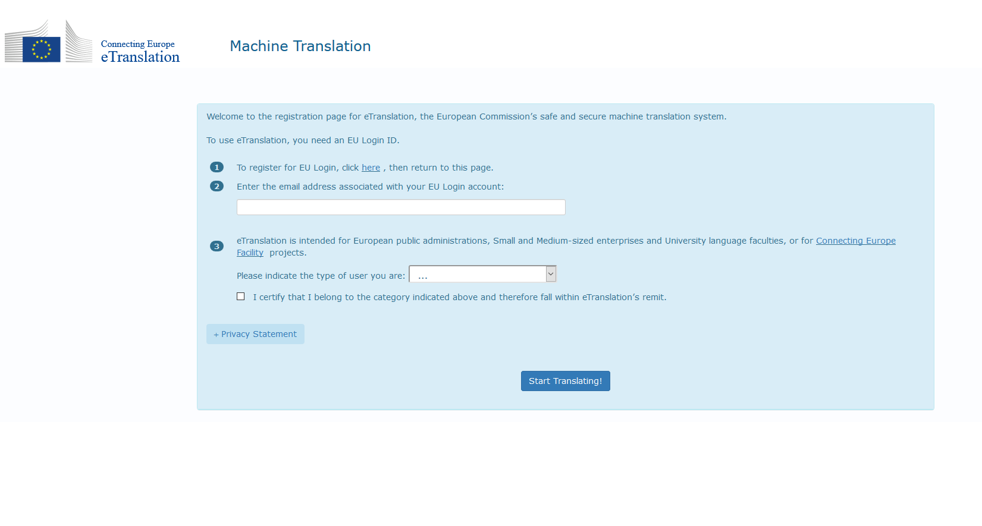
Registering
Register at: https://webgate.ec.europa.eu/etranslation/public/welcome.html

Slide 26
How to use eTranslation services
You can:
Use the web interface to translate one or more documents or text pieces
Integrate eTranslation with your online services

Slide 27
Translation of documents or text (2)
Your account is opened and you can use the service.If you do not use for 12 months your account will be disabled
Log in and select the preferred machine translation type — documents or text
The result is either saved in a personal space for 24 hours or sent to you via the work email

Slide 28
How to integrate eTranslation with your online services
If you are a DSI or other online public service provider, you can offer your online service to the user in their own language
Integrate this service into your system by connecting via an API provided by the web services to automatically request an automatic translation

Slide 29
Collection and sharing of language resources (data sharing)
To improve service quality and coverage, the system requires increasing and varied amounts of source language/translated language pairs
ELRC — European Language Resource Coordination

Slide 30
Practical use-cases
Translation
General rapid translation
— translation of material in the absence of a contracted translator/company etc.
Bilingual work e.g. press releases, etc.
Starting a project with a linguistic dimension
Gisting/‘grey translation’ in the case of ‘exotic’ languages

Slide 31
Keep in touch
ec.europa.eu/
europeancommission
europa.eu/
@EuropeanCommission
@EU_Commission
EUTube
@EuropeanCommission
EU Spotify
European Commission
Notes:
Delete/update as appropriate

Slide 32
eTranslation brings…
11/8/2019
Reliable and trustworthy translation for EU and Member State public administrations
Support for languages with fewer speakers (multilingualism policy)
Opportunities for private sector (eTranslation integration)
A higher profile for language technologies, thus fostering demand
Public availability of data collected by ELRC
ELRC Workshop, Malta, 1 November 2019
33

Slide 33
Solve your language problems!
11/8/2019
ELRC Workshop, Malta, 1 November 2019

Slide 34
11/8/2019
Grazzi!
Thank you!
Thank you!

Slide 35
Thank you
© European Union 2020
Unless otherwise noted the reuse of this presentation is authorised under the CC BY 4.0 license. For any use or reproduction of elements that are not owned by the EU, permission may need to be sought directly from the respective right holders.
Slide xx: element concerned, source: e.g. Fotolia.com; Slide xx: element concerned, source: e.g. iStock.com
Notes:
Update/add/delete parts of the copy right notice where appropriate.
More information: https://myintracomm.ec.europa.eu/corp/intellectual-property/Documents/2019_Reuse-guidelines%28CC-BY%29.pdf

