Slide 1
Election Manifest 2022
Malta Chamber of SMEs

Slide 2
5
1
3
2
3
5
2
4
0
1
0
3

Slide 3
Fair Tax
Tax benefit reduction for all
Final and not taxable further
No tax on transfers direct to family members

Slide 4


SME Chamber I Manifest 2022
Covid Wage Supplement +
Deferred Taxes
Extending COVID safetynet

Slide 5

Mitigating Price hikes
Remove Excise
Reduce VAT
State Aid implications
Freight Free Zone

Slide 6
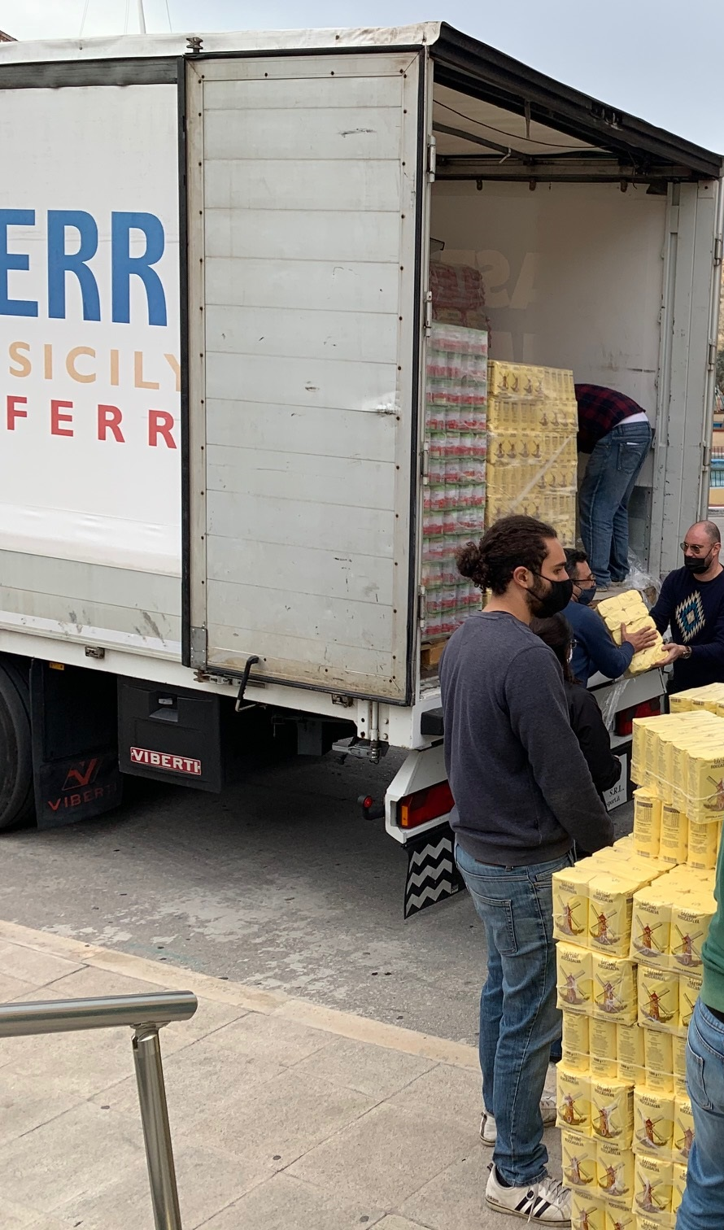
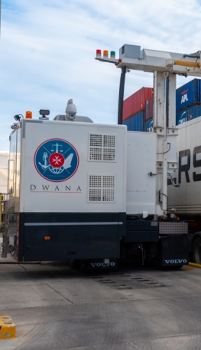
Unfair Competition from Sicily

Slide 7

SME Chamber I Manifest 2022
Banking services supervision
Task Force – Charter for Banking Services
Banking Services Supervisory board
Investigation by MCCAA on abuse of dominance
Strengthening Arbiter for Financial Services
Addressing the adverse banking environment

Slide 8

Ease of doing business & Good Governance
SME Chamber I Manifest 2022
Ease of doing business Scoring
Assessment System - Govt Entities
Malta – Brexit
Procurement & Direct orders
Accountability
Regulator
Audit on micro companies

Slide 9
Employment & Training
Fully financed training scheme
Transparent Recruitment Process
TCNs: Centralised and Efficient

Slide 10


SME Chamber I Manifest 2022
Awareness campaign
Incentive Scheme
Cyber Crime Protection

Slide 11
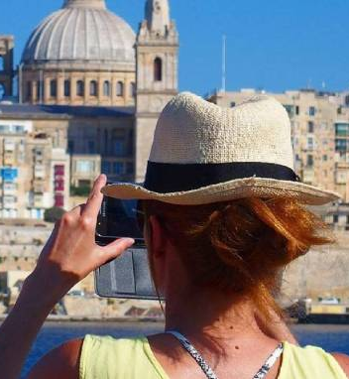

Malta competing according to COVID restrictions
Travel linked vouchers
Incentivise airlines
Reinvigorating Tourism

Slide 12
Other proposals
SME Chamber I Manifest 2022
Health
Carbon Neutrality in Transport
Gozo

Slide 13


