Slide 1
Change to Grow
MALTA ENTERPRISE

Slide 2
General Overview
SMEs can seek support from external advisors to assist them in carrying out significant changes that will enable them to:
- accelerate development
- address sustainability and improve market access to enhance their processes
- embrace digital technology
- and implement sustainable solutions
Notes:
put text under start of sentence

Slide 3
Eligibility
Eligible applicants include:
- self-employed person
- SMEs
Having at least one full-time employee
This scheme is a de minimis measure
Notes:
put text under start of sentence

Slide 4
Support
A maximum grant of €10,000 disbursed as a reimbursement of 75% of eligible costs incurred
Advisory Stage
- Up to €5,000 and up to €120/hour
Implementation Stage
- Up to an additional €5,000
Notes:
put text under start of sentence

Slide 5
Advisory stage
Qualifying Advisory Services:
Product process certifications
Customer handling procedures
Pricing analysis
Market positioning
Human resource optimisation
Other actions as may be justified by the applicant
Digitisation of business processes
Performance optimisation
Process improvements
Environmental performance and sustainability
Implementation of quality systems
Beneficiaries are to complete the Advisory Stage within six (6) months of approval
Notes:
put text under start of sentence

Slide 6
Smart and Sustainable
MALTA ENTERPRISE

Slide 7
Eligibility
Economic activity that operates from a licensed commercial property
Investment project of minimum €10,000
Achieve Sustainability, improved Environmental Performance or Digitisation
This scheme falls under the de minimis regulation
The deadline is that of 30th November 2023
1 FTE registered with Jobsplus (including Self-Employed FTE)
Notes:
put text under start of sentence

Slide 8
support
50% of investment costs up to a maximum of €50,000 per project
and
Top up of a 10% or 20% Tax Credit on any One or Two of the below:
Project results in a new / expansion of investment in Gozo
Project carried out by an undertaking established for < 3 years (Startup)
Project supported by an independent carbon footprint audit and assessment demonstrating a significant reduction in applicant’s carbon foot print
Notes:
put text under start of sentence

Slide 9
eligible costs
Upgrades, Improvements or Modifications in plant, machinery, equipment and in digital technologies of what is currently being used by the entity
Supported investments must be implemented within 12 months from the date when funding is approved
Beneficiary must commit to maintain the investment for at least 3 years
Applicants can submit more than 1 application
Notes:
put text under start of sentence

Slide 10
eligible investments
WASTE MINIMISATION
The introduction of new industrial solutions or strategic modifications to existing plant. Reduction in materials per production unit and reduction in packaging and increase of lifespan products.
SUSTAINABLE MATERIALS
Investments in the change of materials in production process and products which ensure better recovery of material at product’s end of life. These will include sustainable and/or ecologically- friendly material and reduction/ elimination of toxic material.
Investment can include
a)Pilot Projects and b)Changes in the value chain
Notes:
put text under start of sentence

Slide 11
eligible investments
ENERGY EFFICIENCY
Investments in solutions to reduce power requirement in relation to machinery and lighting, improving insulation of buildings, investments in co generation of heat and power and geo-thermal installations.
WATER EFFICIENCY
Investments in solutions to improve water usages such as investments in closed-cycle water systems and investment to store run-off rain water.
Notes:
put text under start of sentence

Slide 12
eligible investments
SUSTAINABLE DIGITALISATION
Adopting digital solutions to enhance environmental performance such as:
a) Increase process efficiency through IoT (smart HVAC, system monitoring)
b) Solutions to establish enhance (optimise) logistics, including partnering with
other firms, resulting in reduction of carbon emissions
c) The installation of building management systems to optimise heat, light and
power usage
d) Industry 4.0 solutions leading to higher automation and rapid customer
focused customisations
Notes:
put text under start of sentence

Slide 13
Investment Aid for Energy Efficiency Projects

Slide 14
introduction
This measure aims to facilitate investments in technological solutions that provide higher energy efficiency and which contribute directly towards a reduction in energy requirements
The aid awarded shall be in the form of a cash grant or a tax credit or a combination of both
Notes:
put text under start of sentence

Slide 15
eligible projects
Investment in substitution or upgrading of equipment and installations to reduce energy consumption
Renovation or upgrading of equipment of existing installation for heating or cooling systems
The improvement of energy efficiency of existing illumination systems
An energy audit carried out by a certified energy auditor or a specific proposal prepared by a warranted engineer is required
Notes:
put text under start of sentence

Slide 16
minimum project threshold
Only costs directly linked to the achievement of a higher level of energy efficiency shall be considered eligible
The eligible costs shall be the extra investment costs necessary to achieve the higher level of energy efficiency
The project must entail an investment of at least €10,000 that is directly related to achieving at least 10% energy savings
Notes:
put text under start of sentence

Slide 17
Aid intensity
Support = Eligible Cost x Aid Intensity
Small Enterprises
50%
Medium Enterprises
40%
Large Enterprises
30%
Notes:
put text under start of sentence

Slide 18
Case
Studies

Slide 19
Case study 1
Applicant: Medium Sized Company
Investment: Add equipment to existing air handing installation which will (solely) increase the efficiency of the system.
Project Value: €150,000 excluding Vat
Scheme: Investment Aid for Energy Efficiency Projects
Aid Intensity: 40%
Funds Disbursed: €60,000 Cash Grant

Slide 20
Case study 2.1
Applicant: Self-Employed
Request: Advisory on Digitisation of Business Processes
Advisory Service Cost: €4,000 excluding VAT
Scheme: Change to Grow Phase 1
Aid Intensity: 75%
Funds Disbursed: €3,000 Cash Grant

Slide 21
Case study 2.2
Applicant: Self-Employed
Investment: Implementation of cloud-based Enterprise Resource Planning solution which will improve efficiency of processes
Project Value: €8,750 excluding Vat
Scheme: Change to Grow Phase 2
Aid Intensity: 75%
Funds Disbursed: €5,000 Cash Grant

Slide 22
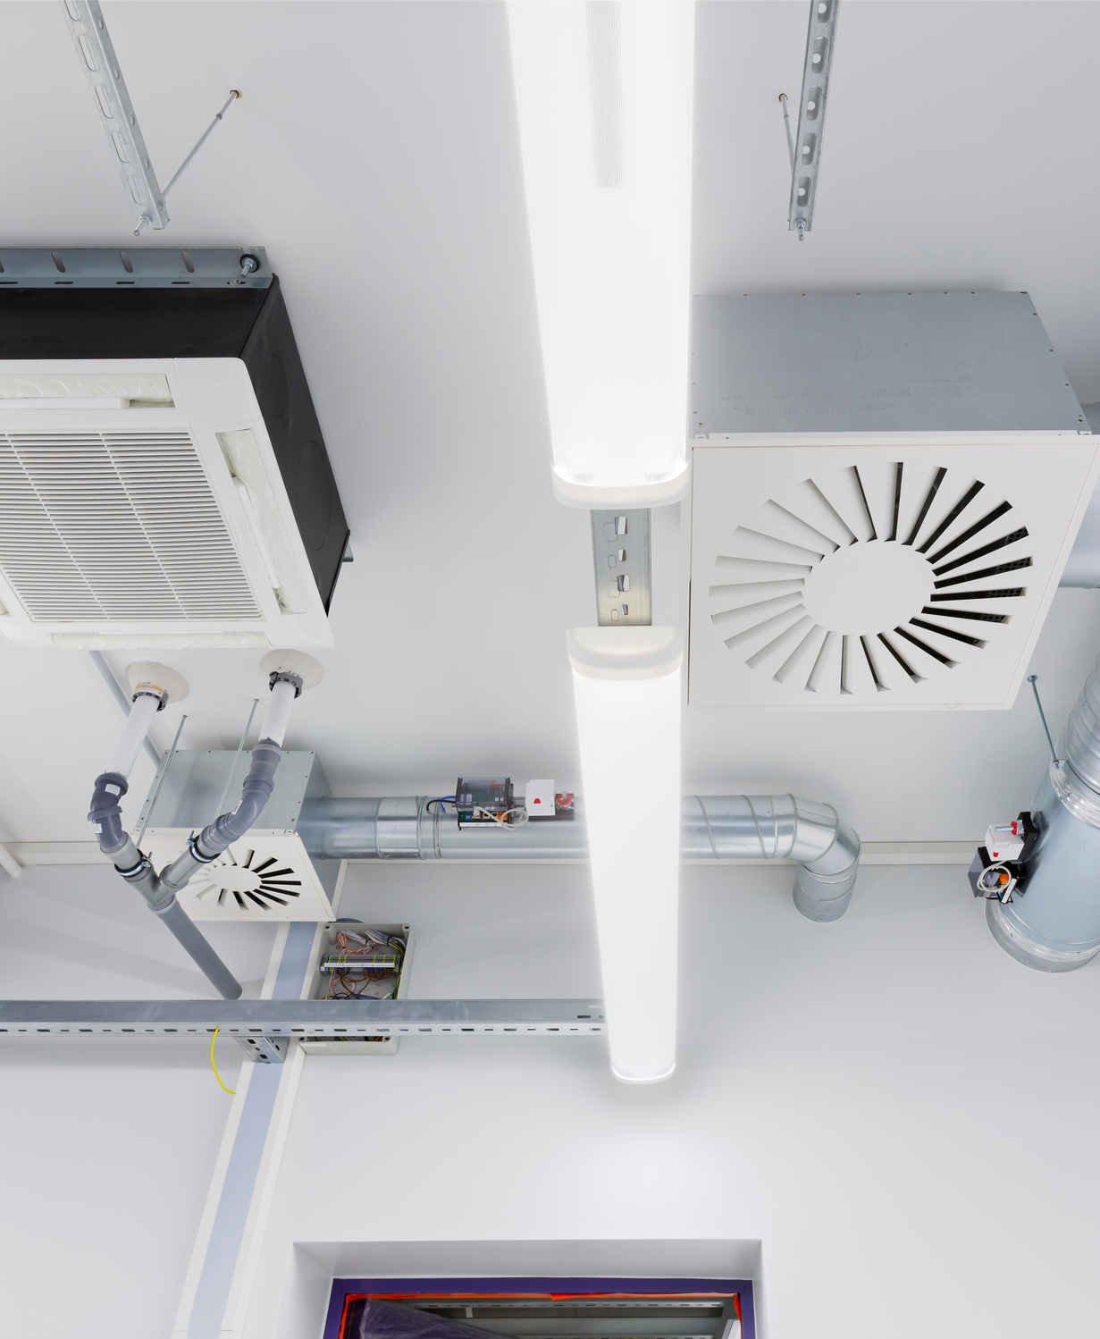
Case study 3
Applicant: Large Company
Investment: Replacing all AC’s with a Smart
HVAC System and Optimisation of Logistics
by partnering with other firms
Project Value: €90,000 excluding VAT
Scheme: Smart and Sustainability Grant
Aid Intensity: 50%
Funds Disbursed: €45,000 Cash Grant

Slide 23
Official Incentive guidelines can be downloaded from:
http://support.maltaenterprise.com
For support and guidance contact Business 1st
114
info@businessfirst.com.mt

