Slide 1
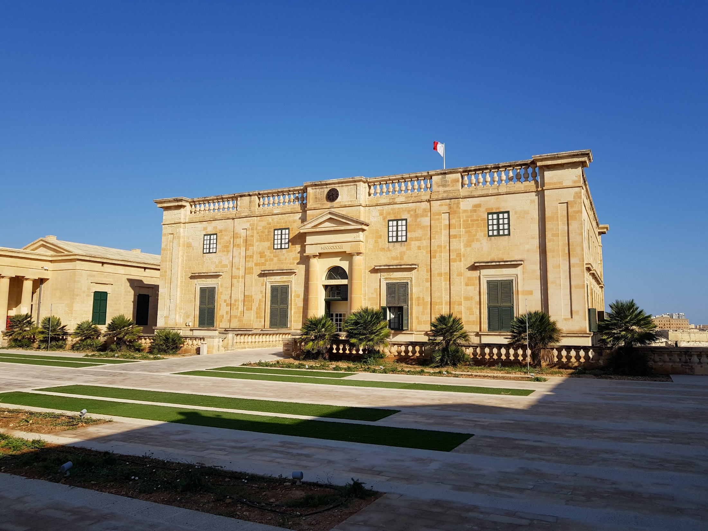
The Malta Council for
Science and Technology
Funding Opportunities - R&I Programmes
Notes:
Good afternoon and thank you for your interest in the funding programmes offered by the Malta Council for Science and Technology. I am Abigail Aquilina and I work within the R&I Unit as an executive of funding programmes.

Slide 2
The Malta Council for Science & Technology
MCST is a Government entity established in 1988.
The R&I Programmes Unit manages national funds for Research and Innovation. Funding programmes include networking schemes, funds for basic research and also applied research.
MCST Technical Units
R&I Unit
Policy and Strategy Unit
Framework ProgrammeUnit
Internationalisation Unit
Notes:
Let me start with a brief introduction about our entity. MCST is a government entity and it has been established in 1988. There are 4 technical units in MCST which are the R&I unit, the Policy & Strategy unit, the Horizon Europe unit and the Internationalisation unit.
The R&I Programmes unit manages national funds for research and innovation where the funding programmes offered include networking schemes, funds for basic research and also those applied research.

Slide 3
State Aid
State aid is the legal instrument by which the Government provides funding to other entities. 2 parts:
De Minimis: €200,000 de minimis aid over a three year period.
GBER (General Block Exemption Regulation): has a very high cumulation but is more rigorous when it come to determining the funding percentage.
0
Notes:
Since 2014, the FUSION programme has provided over €12 million euros in funding for Research and Innovation activities.
As I have briefly introduced, FUSION incorporates a wide portfolio of funding programmes, which accommodate an extensive technology readiness spectrum, and also range from ones which are non-thematic to other which are more specific and niche, therefore raising the level and profile of R&I in Malta.

Slide 4
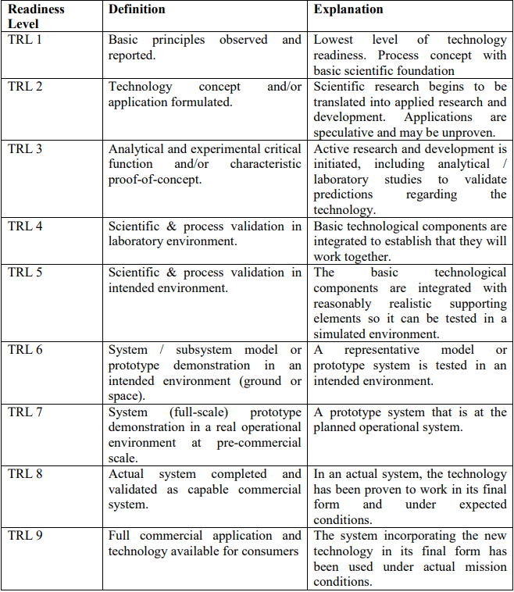
Technology Readiness Levels
0
Notes:
Since 2014, the FUSION programme has provided over €12 million euros in funding for Research and Innovation activities.
As I have briefly introduced, FUSION incorporates a wide portfolio of funding programmes, which accommodate an extensive technology readiness spectrum, and also range from ones which are non-thematic to other which are more specific and niche, therefore raising the level and profile of R&I in Malta.

Slide 5






Networking
Opportunities for collaboration initiatives with foreign research counterparts
IPAS+
Basic Research
Funds for early- stage, innovative research
REP
Thematic
SRF
R&I Unit Funding Programmes
Applied Research
Funds for late-stage, developmental research
CVP + Opt. Vouchers
TDP
TDP Lite
Thematic
SRF
Notes:
The following figure summarises the different funding programmes which cater for different aims.
IPAS+ serves as an opportunity for collaboration initiatives with foreign research counterparts.
REP, the thematic programme as well as SRF are funds for early-stage, innovative research.
Finally, the CVP, TDP, the thematic programme and also SRF are funds for late-stage, developmental research.
Throughout the rest of the presentation, I will provide further details on each funding programme.

Slide 6
Introduction to IPAS+
There are two options for IPAS+:
Option A: Opportunities for collaborative initiatives between Maltese entities and at least one foreign entity of proven track record of excellence and experience.
Option B: Opportunities for Maltese entities intending to submit a Horizon Europe proposal as the coordinator of the consortium to engage a service provider.
Each Option received a funding of up to €5,000. Next year funding limit will be increased up to €6,000
Funding for 2022: Eur100k for Option A and Eur50k for Option B
Next Call is to be launched March 2022.
0
Notes:
The Internationalisation Partnership Awards Scheme Plus is a scheme divided into two options.
Option A is an opportunity for collaborative initiatives between Maltese entities and at least one foreign entity of proven track record of excellence and experience. Hence, the proposals should describe the nature of the joint activities that would be funded through this award. One needs to ensure to demonstrate how the proposed activities contribute towards achieving the goals of the national R&I strategy.
With respect to Option B, this serves as an opportunity for the Maltese entities intending to submit a Horizon Europe proposal as the coordinator of the consortium to engage either a local or foreign service provider who will be supporting the applicant.
The amount of the award available to any successful applicant for each option is capped at €5,000.
The IPAS+ is launched as two calls per year, where the first call was launched during May and the second call is to be launched mid-September of this year.

Slide 7

Introduction to FUSION
Since 2014, the FUSION programme has provided over € 12 million in funding for Research and Innovation.
FUSION incorporates a wide portfolio of funding programmes, which accommodate an extensive technology readiness spectrum, and also range from ones which are non-thematic to others which are more specific and niche, thus raising the level and profile, of R&I in Malta.
0
Notes:
Since 2014, the FUSION programme has provided over €12 million euros in funding for Research and Innovation activities.
As I have briefly introduced, FUSION incorporates a wide portfolio of funding programmes, which accommodate an extensive technology readiness spectrum, and also range from ones which are non-thematic to other which are more specific and niche, therefore raising the level and profile of R&I in Malta.

Slide 8




Introduction to FUSION
Research Excellence Programme
Bottom-up, Early stage, Basic research
0
Special Programmes
Address immediate, national needs or market failures
May only run once
Commercialisation Voucher Programme
IP, Commercialisation and Feasibility studies prior to applied research
Pre-requisite to TDP
Technology Development Programme: LITE
Expedited Applied Research Programme
Individual
Short Term
Technology Development Programme
Applied Research following Feasibility Assessment
Collaborative
Notes:
The Research Excellence Programme was launched last year as a pilot scheme, specifically intended to fund early-stage research through a bottom-up, non-thematic based approach where an innovative research idea can be developed; this programme mainly provides support to early-stage fundamental or industrial research.
If the innovation is at a more advanced technology readiness level, the researcher can tap into the Commercialisation Voucher Programme (CVP). The CVP aims at assisting researchers to assess the commercial and market potential of their ideas, prior further investing in their research.
The Technology Development Programme provides financial support for a project to build on the outcomes of the CVP. At this stage, research and development takes place through an established collaboration between the public and industrial sectors with the main aim of commercialising the technology which has been developed.
The intent is to also launch a fast-track TDP programme.
This year, the council has launched a special top-down research programme designed to target national needs, which is the Infectious Diseases Programme.

Slide 9

DataDear: A case study
This technology was developed by DataDear Consortium, represented by Scope Solutions and the University of Malta.
It is a project which received € 195,000 in funds through FUSION.
DataDear project serves as a cloud-based solution for finance and business professionals.
0
Notes:
Since 2014, the FUSION programme has provided over €12 million euros in funding for Research and Innovation activities.
As I have briefly introduced, FUSION incorporates a wide portfolio of funding programmes, which accommodate an extensive technology readiness spectrum, and also range from ones which are non-thematic to other which are more specific and niche, therefore raising the level and profile of R&I in Malta.

Slide 10

Introduction to Space Research Fund
Scope
Financial support for R&D&I in the downstream Earth Observation (EO) sector to tackle societal challenges in Malta.
Capacity building measure to jump start the EO sector.
0
Who can apply?
Research Streams
All Maltese Legal Entities:
Private Entity or
Public Entity or
Public RDI
Stream 1: (TRL 1 to 4)
Stream 2: (TRL 5+)
Up to €150,000
Project Duration
de minimis or GBER or State Aid Not Applicable
20 months across two stages.
Eligible Costs
Typical Consortium Compositions
Personnel (Salaries)
Specialized Equipment
Consumables
Subcontracting
and more
Sole Beneficiary
Public – Private
Public – Public
Private – Private
Notes:
The Space Research Fund is a separate programme which does not fall under FUSION.
Before we dive into the specifics, there are two terms which must be defined.
First, space upstream applications which are associated with development of satellites, rockets. It could be related to hardware or software development. Second is the term downstream applications which uses data coming for existing space infrastructure.
The fund is dedicated for downstream applications, for those who would like to use space infrastructure, in particular using earth observation satellites for the benefit of Malta.
So, the fundamental aims of this fund are to provide financial support for RDI in the downstream Earth Observation sector to tackle societal challenges in Malta as well as a capacity building measure to jump start the EO sector.
There are two separate streams for SRF, both serving as a €150,000 grant for projects with a duration of 20 months, one aimed for early-stage basic research and the other one for more applied, developmental research. Applicants could either opt to be as a single beneficiary or otherwise as part of a consortium.

Slide 11
Thank you for your attendance and interest.
For further information, and to schedule one-to-one meetings kindly contact us. https://mcst.gov.mt/ri-programmes/fusion/
Notes:
This concludes the presentation about the national funding initiatives offered at MCST. Thank you for your interest. Feel free to contact me directly if you would like further clarifications or you would like to schedule a one-to-one meeting. Do not hesitate to ask any questions as I would gladly answer.

