Slide 1


Webinar: Support for Business Innovation
Malta Chamber of SMEs and Malta Council for Science and Technology

Slide 2

Agenda
14:00-14:15 | Introduction: Welcome by Abigail Mamo. SMEs and innovation in Malta – Martin Vieira
14:15-14:30 | Overview of R+I Unit Funding Schemes & Programmes – Mr. Owen Zammit & Mr. Stephen Borg (RI Unit)
14:30-14:45 | Overview of Funding Opportunities in Horizon Europe Programme – Mr. Martin Vieira and Mark Meilak (FP Unit)
14:45-14:50 | Q&A R+I and Horizon Europe
14:50-15:00 | Break
15:00-15:15 | Overview of Internationalisation Unit programmes – Ms Maria Azzopardi
15:15-15:30 | Review of essential tools and portals and MCST support scheme for proposal development (IPAS, EIC, PRIMA section 1 and 2) – Mr Martin Vieira
15:30-15:35 | Q&A Internationalisation, tools and portals and proposal support schemes
15:35-16:00 | Concluding remarks and Break out rooms (3x)

Slide 3



SMEs and innovation
Excessive competition
Lack of skilled staff
High costs

Slide 4

Why apply to innovation
support funds?
A.
High Funding rates
70 to 100% Funding rates
B.
Grant Funding and investment finance
Support in mode of non-refundable grants
C.
Competitive edge
Invest to get the competitive Edge you need to stay ahead in your field
D.
Collaborative environment
Build a network with key stakeholders in the EU R&D, innovation and entrepreneurial community
E
Support available in all areas
Get support in developing all aspects of your business while doing the application process with the support of the EU, network and MCST
F
Upskill your staff
Ability to invest in staff and give them growth opportunities.
Notes:
No of signed Grant Agreements with MT participants - 190
MT unique participants - 77
Total EU Net funding for MT (Net SMEs contribution) - > € 37 million
MT success rate 13.94%
EU28 success rate 15.29%

Slide 5

SME: important factors for innovation activities
Intrafirm:
Need for a formal initiative
Skills upgrading
Spaces to strategise with employees
External:
Extent and quality of networks
Specialised advisor or new staff
Use of technology intermediaries and support agencies
Personal:
Embeded practical knowledge
Shared vision or objectives
Learn from others’ success
Thorpe et al 2008

Slide 6

R+I Unit
Owen Zammit and Stephen Borg
DISCLAIMER:
This is preliminary information that is subject to change according to rules of each Call launched.

Slide 7
Framework Programme Unit
Martin Vieira and Mark Meilak
DISCLAIMER:
This is preliminary information that is subject to change according to rules of each Call launched.

Slide 8
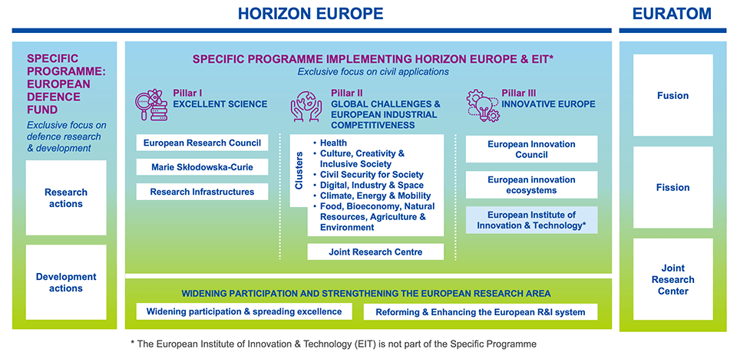
Horizon Europe – 2021-2027

Slide 9

Pillar II: Eligibility criteria
3 legal entities from 3 different Member States or Associated Countries* and with at least one of them established in a Member State.
You may bring on board other partners from any country;
Allocate necessary resources for the duration of the project;
As from 2022, Gender Equality Plans will be an eligibility criteria for public bodies, research organisations and higher education institutions.
Always check the HE General Annexes for the updated list of Associate Countries.

Slide 10

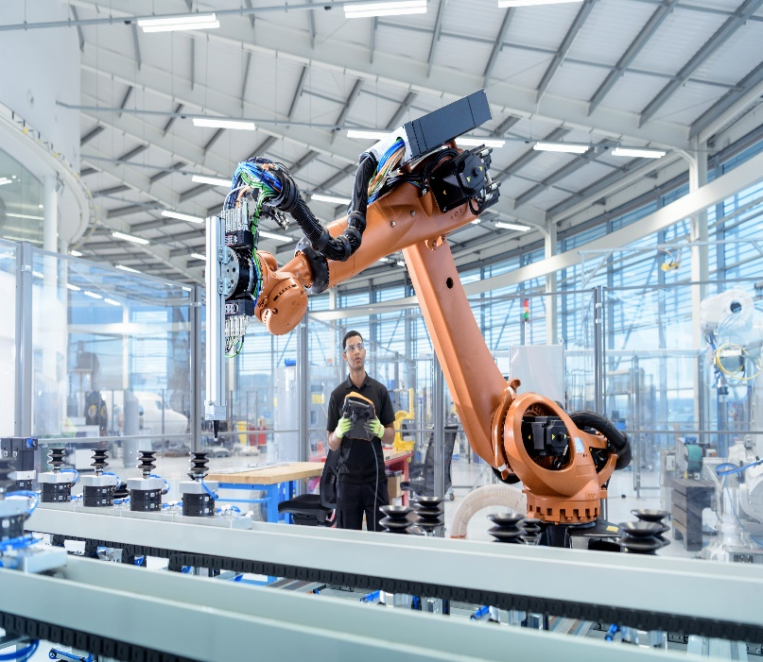

Pillar III:
European Innovation Council (EIC)
European Innovation Ecosystems (EIE)
European Institute of Innovation and Technology (EIT)
EIC
Supporting breakthrough technologies and game-changing innovations. Aimed at SMEs.
EIE
Creating more connected and efficient innovation ecosystems to support the scaling of companies, encourage innovation and stimulate cooperation.
EIT
Support the development of dynamic, long-term European partnerships among leading companies, research labs and higher education, through Knowledge and Innovation Communities (KICs).
Notes:
Programmes under pillar III are complementary and seek synergies.
Themes may include gene therapies, Novel RNAs, Cardiogenomics, Space regenerative medicine, High Tech Mental health practitioner
Time to grant from application: 8 months

Slide 11
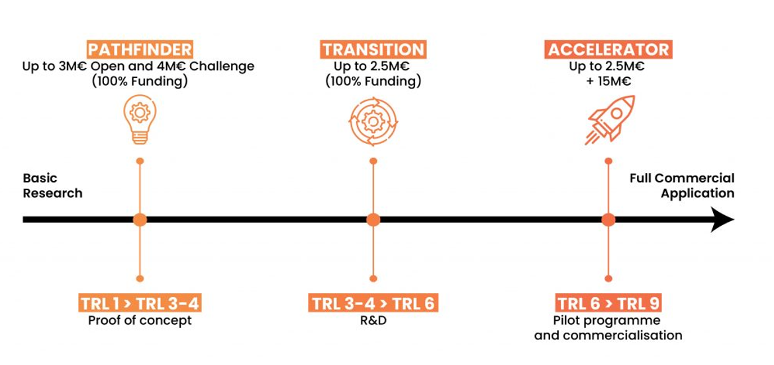
Pillar III: European Innovation Council funding schemes

Slide 12
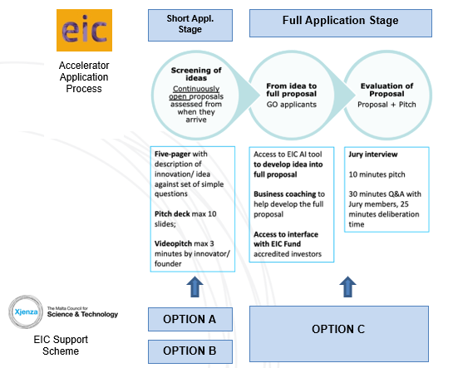
MCST EIC Support Scheme
Business Coach (Option A - €5000)
- Business Development of idea
- Organisational Development
Financial Development
Pitch Coach
(Option B - €2000)
- Investor Pitch Support
- Practice Session and suggest
- Video scripting and structure
- Preparation of Pitch Deck
Consultancy & Proposal Writer
(Option C - €10000)
- Project Idea Formation
- Create work plan
- Project budgeting
- Business plan compilation

Slide 13
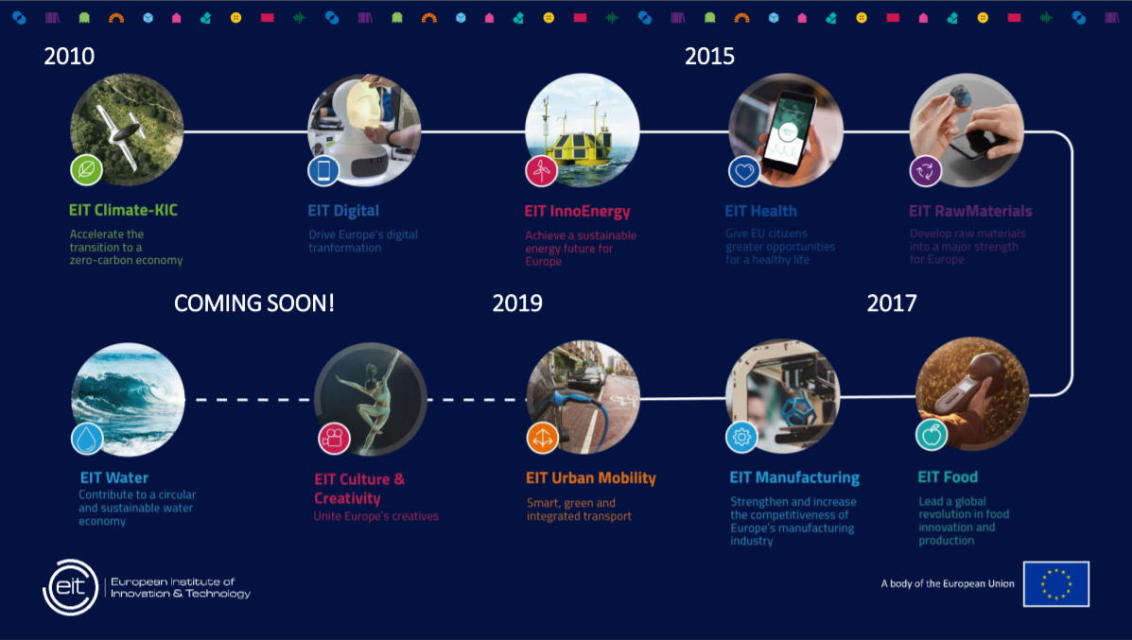

Slide 14
Internationalisation Unit
Maria Azzopardi
DISCLAIMER:
This is preliminary information that is subject to change according to rules of each Call launched.

Slide 15

Aims and Objectives
The main aim of the internationalisation unit is to strengthen international R&I collaboration amongst local and foreign researchers and stakeholders
The Unit implements regional and international funding programmes, using national funds, aimed at the local R&I stakeholder community

Slide 16





Internationalisation Programmes
Multilateral Programmes:
PRIMA
BlueBio ERA-NET COFUND
Bilateral Programmes:
Sino-Malta Fund
MCST-TUBITAK (PRIMA S3)
Horizon Europe Partnerships (multilateral):
Clean Energy Transitions
Sustainable Blue Economy
Transforming Health and Care Systems

Slide 17
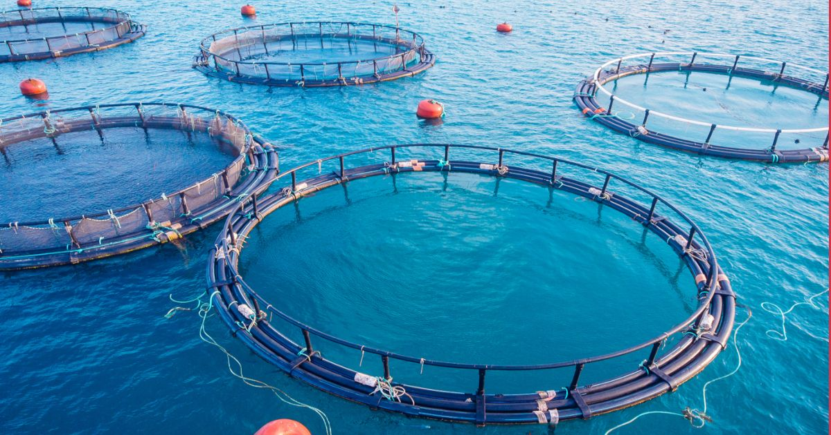
Blue Bio
ERA-NET Co-Fund
The main objective is to establish a coordinated R&D funding scheme that will strengthen Europe’s blue bio economy.
A 3rd additional Call is still being discussed, to be launched in 2022.
National Budget Allocation: € 300,000
https://bluebioeconomy.eu/
Notes:
The COFUND is the result of a collaboration between JPI Oceans and the former ERA-NETs COFASP (2012 – 2017) and ERA MBT (2012 – 2017) and consist of 32 partners from 17 European countries.

Slide 18
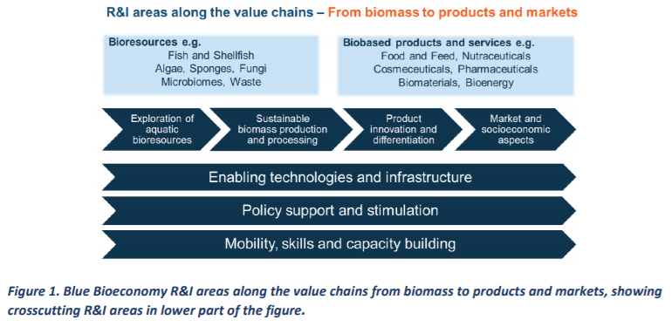

Slide 19
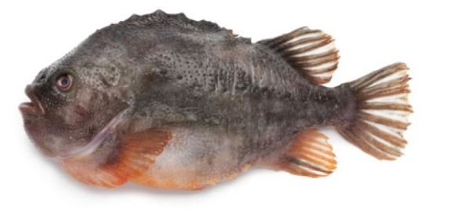
PROFIUS
The aim of PROFIUS is to address challenges in the supply chain related to lumpfish (roe and carcass) and tuna side-streams by developing preservation solutions for maintaining quality and improving utilization of the entire biomass.
Improved preservation methods will be developed to enhance quality and shelf life of lumpfish roe and thereby reduce waste. A major bottleneck for success of further utilization of the side-stream from tuna is their short shelf life.
PROFIUS will study the processes responsible for the chemical and microbial deterioration of these side-streams and develop strategies to prevent them. Furthermore, PROFIUS will look into new applications of lumpfish and tuna side-streams including logistics and development of gelatin extraction processes for lumpfish and development of fish feed based on tuna side-streams.
Technical University of Denmark, Denmark (Coordinator),
AquaBioTech Group, Malta,
Norwegian University of Science and Technology, Norway,
University of Akureyri, Iceland
Sjávarfíftæknisetrið BioPol ehf, Iceland

Slide 20


An Article 185 Initiative for a programming period of 10 years involving both EU and non-EU countries (PRIMA participating states).
Align national R&I policies and budgets to strengthen cooperation and avoid fragmentation of R&I efforts in the Mediterranean.
Supports transnational R&I projects in the Mediterranean Area
  Water scarcity and overexploitation of natural resources
  Population growth and food security issues
  Lack of innovation in Mediterranean agro-food value chains
  Unsustainable agricultural practices
  Agro-biodiversity loss
  Climate change
https://prima-med.org/

Slide 21
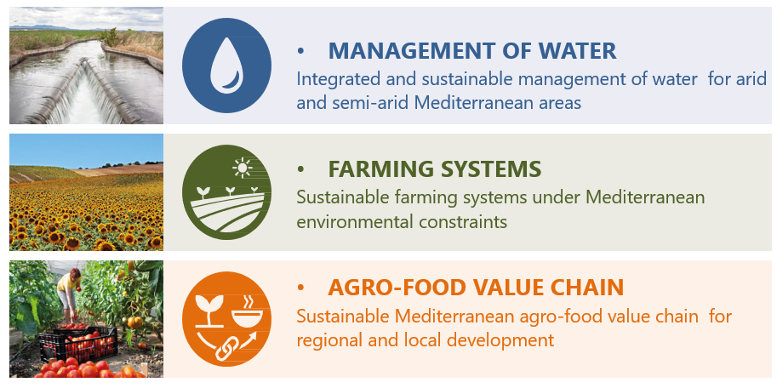
Thematic areas

Slide 22

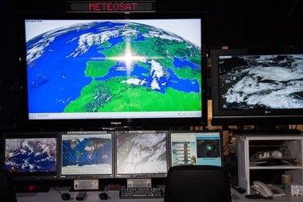

Some food for thought…
GIS technologies (Geographical Information System) platforms to analyse spatial and geographic data for ground water management
Innovative sensor technology for smart irrigation
SMART technologies to improve water quality
Food drying technologies
Drones for monitoring and analysis of crop health, soil and fields, planting and crop spraying and irrigation.

Slide 23


MCST-Tübïtak Bilateral
The 2021 Joint Call for Proposals of MCST-TÜBİTAK Bilateral Research & Innovation (R&I) Projects were carried out in accordance with the framework of this said collaborative agreement.
MCST Call Budget: € 200,000 for 2 projects

Slide 24

SINO-Malta Bilateral
The SINO-MALTA Fund Call for Proposals for Science and Technology Cooperation is carried out based on the agreements by the Joint Commission on Science and Technology.
Thematic Areas for 2022:
  Health,
  Green Transitions,
  Digital Technologies
Call Budget: € 600,000 for 3 projects

Slide 25

Horizon Europe Partnerships
Clean Energy Transition Partnership
Sustainable Blue Economy Partnership
Transforming Health Care Systems Partnership

Slide 26
Co-funded Horizon Europe Partnerships
The Co-funded Horizon Europe Partnerships involve EU countries, research funders and other public authorities. These partnerships bring the European Commission and private and/or public partners together to address some of Europe’s most pressing challenges through concerted research and innovation initiatives.
MCST, on behalf of Malta, shall be participating in the following three partnerships (2021 – 2027):
  Clean Energy Transition Partnership
  Sustainable Blue Economy Partnership
  Transforming Health Care Systems Partnership

Slide 27
Proportion of Applicant Stakeholders
MCST strives to support more SMEs to undertake R&I activities:
we can guide you to apply to the most relevant Calls,
assist you with the search of international partners.
Notes:
To include any statistics about current stakeholders or projects that were funded that included SMEs and what these projects were about.

Slide 28


Facilitate proposal writing - schemes
Organise Information Sessions
Organise One-to-One sessions for tailor-made advice
Facilitate search for partners - plumtri
Networking opportunities – brokerage events
Thank You
Contact email address:
international.mcst@gov.mt

Slide 29

Enterprise Europe Network - een.ec.europa.eu
Find partners and offer services to companies across the EU, as well as accessing events and business services.
Tools and portals
Plumtri - plumtri.org
Platform for R+I partnerships and opportunities focused on the Mediterranean region
Funding and Tenders Portal - ec.europa.eu/info/funding-tenders/opportunities/portal/screen/programmes/horizon
Main EU portal to find financing and collaboration opportunities in EU’s innovation programme.
EU Around Me - european-union.europa.eu/contact-eu/meet-us_en?country=MT&level1=MT0&level2=MT00
Find relevant EU networks and initiatives around you.
Use the national network
Malta Chamber for SMEs, Malta Enterprise, Government’s EU Funds Unit, MCST….
Notes:
Tenders and funding portal
Enterprise Europe Network
Plumtri
https://european-union.europa.eu/contact-eu/meet-us_en?country=MT&level1=MT0&level2=MT00

Slide 30
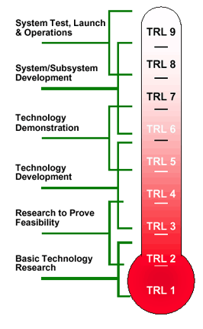






Overview of EU and MCST innovation main funding schemes

Slide 31
Thank You
Room 1: Horizon Europe – Horizon.malta@gov.mt
Room 2: R+I Fusion - rtdi.mcst@gov.mt
Room 3: Internationalisation unit - international.mcst@gov.mt

