Slide 1
Webinar
04th May 2021
@10:30am
Sound & Audio Visual Sector
Picture of webinar

Slide 2
Access to Employment (A2E) Scheme
Ms Christianne Hollier
Project Leader

Slide 3
Access to Employment Scheme
Brief Overview

Slide 4
Access to Employment (A2E) Scheme
Provides employment aid to enterprises in Malta and Gozo to promote the recruitment of the more challenged amongst job seekers, unemployed and inactive persons.
Notes:
Access to Employment (A2E) Scheme provides wage subsidy to enterprises in Malta and Gozo.
The Scheme is demand driven and grants will be awarded on a first-come first-served basis. The total available budget for the A2E is €12 million.
All employers are eligible whilst various client groups may be engaged (Locals and European Citizens). Asylum Seekers and TCNs are not eligible.

Slide 5
Timeline Logic of the A2E Scheme
1 June 2015
- Launch of 1st Call
- Budget of €12M
- Rate of €85 / €125
1 Jan. 2020
- Launch of 2nd Call
- Remaining available budget €4.5M
- Rate increased to € 104 / € 155
- Total amount paid €5.6M
1 Oct. 2020
- Launch of 3rd Call
- Amendments in the target groups
- Prolongation of scheme up to Dec 2023
1 Jan. 2021
- Launch of Call 3.1
- Rated increased to €104.5 /€156.50
- Still available budget €1.7M
- Total amount paid €7M
30 Apr. 2021
- Still available budget €500K
- Total amount paid €7.7M

Slide 6
A2E Scheme: Subsidy rate per week
AN INCREASE IN THE SUBSIDY COST
FROM €85 TO €104.50 AND FROM €125 TO €156.50
As from Call 2 Cost of Living Allowance will increase annually

Slide 7
Target Groups
Unemployed for the previous 6 months / 12 months / 24 months
Single Adults looking after Dependants
Individuals who have not attained an upper secondary level education
Registered Disabled Persons
Over 50 years of age
Youths (15 to 24 years) who completed the Youth Guarantee / Work Exposure /Traineeship Scheme
Notes:
Asylum Seekers and TCNs are not eligible. Also British who come after the 1st January 2021 will not be eligible
Target Groups
Any person of age 24 and over who has been unemployed/inactive for the previous 6 months;
Any unemployed person of age between 15 to 24 who previously participated and completed the Youth Guarantee / Work Exposure / Traineeship Scheme and is recruited for the first-time following completion of such initiatives;
Any person who is living as a single adult who has one or more dependants and is not in full-time employment;
Any person of age 24 and over who has not attained an upper secondary educational or vocational qualification (ISCED 3) and who does not have a job;
Any person older than 50 years who does not have a job;
Any person who has been unemployed/inactive for the previous 12 months during which he/she has not benefited from a traineeship with the applicant undertaking and who belongs to either category (3) to (5);
Any person of age 24 and over who has been unemployed/inactive for the previous 24 months during which he/she has not benefited from a traineeship with the applicant undertaking;
Any person who is a registered disabled person under national law.

Slide 8
Registered Disabled Persons Target Group 8
For Client Group 8 (Registered Disabled Persons), the following scenarios will be eligible:
RDP Unemployed , or
RDP in part-time employment, or
RDP in full time or part time employment but registered as disabled worker after the issue of the 3rd Call. The company employing him/her may receive support under Target Group 8, starting from the moment when a grant agreement is issued.

Slide 9
Eligible Employers
Eligible applicants cover all Employers having an economic activity irrespective of their legal form. These include partnerships, companies, family businesses, associations, individual self-employed or other body of persons, NGOs and Social Partners.
NGOs and Social Partners not having an economic activity are also eligible to benefit from the scheme.

Slide 10
Participant’s Eligibility Status
Eligible:
Maltese Nationals
EU Citizens
UK Nationals who entered in Malta before 2020
Freedom of Movement by Marriage
TCN Family/EU Dependent
Subsidiary Protection
Refugee
Temporary Humanitarian Protection
Ineligible:
Asylum Seekers
Third Country National
UK Nationals who entered in Malta after 2020

Slide 11
Access to Employment Scheme Duration of Assistance and Retention Period
Disadvantaged Person - 52 weeks - 4 months
Severely Disadvantaged Person - 104 weeks - 8 months
Disabled Person -156 weeks -12 months
Notes:
The Subsidy Period varies according to the target group / employee engaged.
Employer must retain in employment the recruited person for a further period following the subsidised period.
Retention Period
52 weeks -4 months
104 weeks-8 months
156 weeks -12 months

Slide 12
Submission of A2E Application
The Employer has to submitted a written application:
prior to the engagement of the participant; or
within one month from the date of the acknowledgment of receipt date of the A2E Applications.

Slide 13
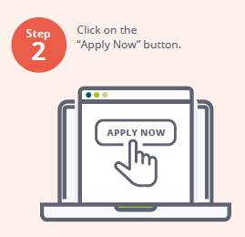
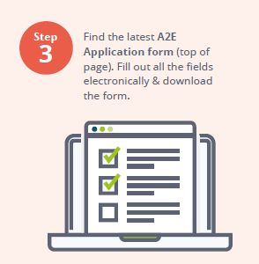
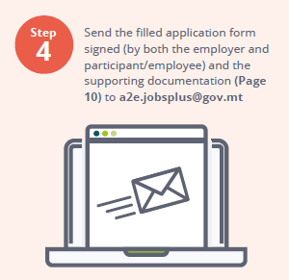
Applying for the A2E Scheme

Slide 14
Payment Process for the A2E Claims for Reimbursement
€
The subsidy (reimbursement of salaries) will be paid to the Beneficiary:
13 weeks;
26 weeks; or
Once terminated prematurely from the employment.

Slide 15
Procedure for the A2E Scheme during COVID-19 Outbreak:
Applications & claims for reimbursements through email from the contact or delegated persons are now being accepted and should be sent on:
a2e.jobsplus@gov.mt
Notes:
Due to COVID scenarios the Application and the request for reimbursement should be submitted thru email.
Grant Agreement is also being signed remotely.

Slide 16
Contact Details:
Project Leader: Christianne Hollier
christianne.hollier@gov.mt
222 01 302
Generic Email: a2e.jobsplus@gov.mt
Generic Phone No: 222 01 399
www.jobsplus.gov.mt
Notes:
Prospective applicants should submit soft copy of the application via email to a2e.jobsplus@gov.mt .
Contact Details: Telephone: 22201302 - Generic email: a2e.jobsplus@gov.mt

Slide 17
Q & A’s
Notes:
Please feel free to send requests and also recommendations and suggestions for the future.
Jobsplus is already working on the new Aid Schemes to be financed thru the new Programming Period 2021-2027. Although the final financial package is still unknow we are working closely with the Ministry for Foreign and European Affairs to secure EU Funds for employers. Any suggestions and recommendations are welcome. You can share them on the generic emails shown in this presentation.

Slide 18
Ms Marthanne Castillo
Project Leader

Slide 19
The Scheme was launched to promote the training of persons actively participating in the Maltese Labour Market, with the aim to increase productivity and enhance adaptability.

Slide 20
IIS Scheme:
The impact of COVID-19 has created an extremely challenging time for the workforce.
If during this period, staff training or up-skilling could benefit your company and its employees, the Investing in Skills Scheme can help and here’s how:
Notes:
On 29th March 2017 Jobsplus launched the IIS scheme to encourage employers to train their staff to enhance their skills. Since then hundreds of employers and thousand of trainees participated in this European Funded Scheme. Today we would like to announce some changes which were lately introduced following the necessary approval of the Managing Authority and the European Commission.

Slide 21
IIS Scheme:
Notes:
To simplify the payment process and based on past Experience a standard scale of Unit Cost was introduced.
Such rate of €25.85 (established following a study performed by Jobsplus and NCFHE now MFHEA) will be paid to the applicant/beneficiary for each trainee trainees for a maximum of 15 trainees.
It should be noted that such capping of 15 trainees is not applicable to travel costs.
Hence Jobsplus will be paying the travel and accommodation costs for all staff travelling abroad, even beyond 15 trainees .
In case of travel we pay the flights – using Erasmus + Commission rates.
Maximum of 25 hours per trainee for non-accredited training. If training is accredited by the MFHEA (Malta Further and Higher Education Authority), ITS (Institute of Tourism Studies), UOM (University of Malta) and MCAST (Malta College of Arts, Science & Technology) the capping of 25 hours will not be applied in cases where the contact hours exceed 25 hours.
In the case of Distance Learning or e-Learning, reimbursement will be calculated on the number of hours indicated by the training service provider using the Standard Scale of Unit cost up to a maximum of 25 hours for nonaccredited training. In the case of accredited training, the reimbursement will be based on the number of hours indicated by the MFHEA or the training service provider in the case of self-accredited institutions.

Slide 22
IIS Scheme:
Notes:
Jobsplus also pays for the Trainees’ Personnel Costs for the hours during which the trainees participate in the training.
5.20 will be paid for each trainee per hour for external training.
In the case of Distance Learning or e-Learning, reimbursement for Personnel Costs will be calculated on the number of training hours if such training is conducted during normal working hours.
No more than 8 hours per day to a maximum of 40 hours a week can be reimbursed.

Slide 23
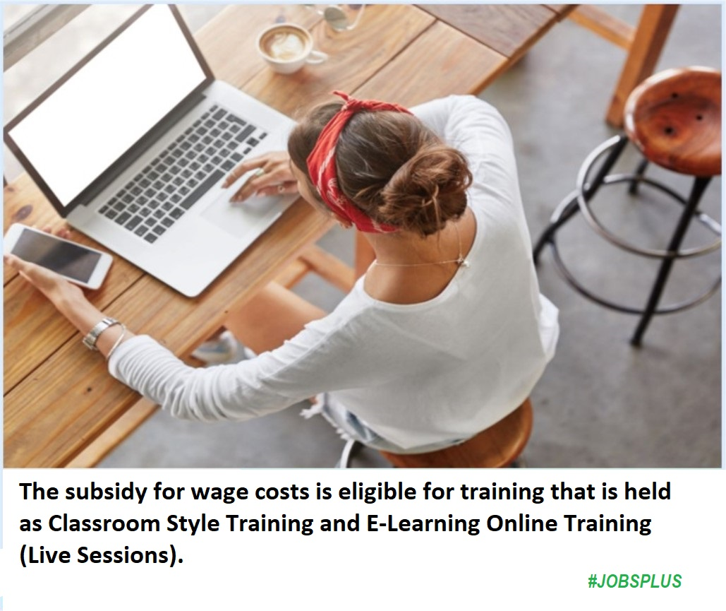
IIS Scheme:
Notes:
As from last week employers can also claim wage cost for on line – distance learning training.
This is a new possibility.
The provision of the online platform and screen shots would be required.
A dedicated form is also available on our website

Slide 24
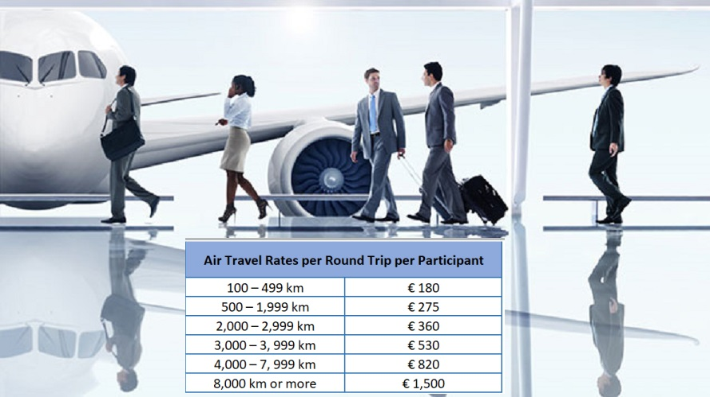
IIS Scheme:

Slide 25
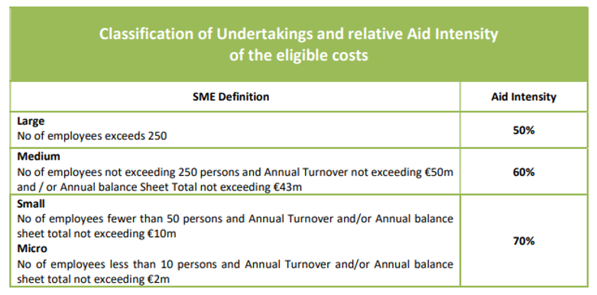
IIS Scheme: A Co-financing rate will be applied on the total eligible cost
In the case of NGOs and Social Partners that do not conduct an economic activity, the headcount of the applicant’s employees will be taken into consideration.

Slide 26
IIS Scheme: Eligible Employers
Eligible applicants cover all Employers having an economic activity irrespective of their legal form. These include partnerships, companies, family businesses, associations, individual self-employed or other body of persons, NGOs and Social Partners.
NGOs and Social Partners not having an economic activity are also eligible to benefit from the scheme.

Slide 27
IIS Scheme: Eligible Trainees
The trainee needs to be formally employed with the beneficiary during the training period irrespective if these are TCNs, EU nationals, Refugees etc.
However, Apprentices or students engaged in vocational training with an apprenticeship or vocational training contract are NOT eligible.
Trainees that are seconded are also NOT eligible unless their direct employer applies for funding.

Slide 28
IIS Scheme:
Notes:
Jobsplus will do its utmost to reduce the approval process. We will be working on a platform to trace and monitor the application. This facility will be given also to employers.
Applications will be processed on a first come first served basis.
Preferably complete applications must be received by the Investing in Skills Unit at least twenty-one calendar days before the start date of training but not later than seven (7) calendar days before the start of the training.
Applications submitted in less than seven (7) calendar days before the start of the training will not be approved.
In line with Article 65 (6) of Regulation (EU) 1303/2013 training can be considered eligible only if it starts after an application has been submitted to Jobsplus and an acknowledgement is issued.
Employers can initiate the training at their own risk prior to formal approval by Jobsplus. Jobsplus will not be held responsible for any losses sustained by the applicant should the application be found ineligible.

Slide 29
Submission of IIS Applications during COVID-19 Outbreak:
IIS Scheme:
Applications & claims for reimbursements through email from the contact or delegated persons are now being accepted and should be sent on:
iis.jobsplus@gov.mt

Slide 30
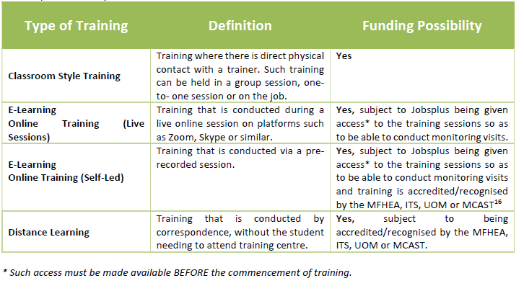
IIS Scheme: Eligible Training Programmes

Slide 31
IIS Scheme: Training that is NOT Eligible
Aid shall not be granted for training which Employers carry out to comply with National Mandatory Standards on training (in other words, it must be voluntary training as opposed to legally enforced training);
Information Sessions;
Team Building events are not eligible under Investing in Skills since these are not considered as training;
Any training provided by a linked company (over 50% shareholding); and
Internal training (where trainers and trainees are employed by the applicant entity, irrespective of their employment status).

Slide 32
IIS Scheme: Documentation for Online/Distance Learning
Application Stage and Implementation Stage:
Besides the IIS Application Form and Training Programme Template, the Training Schedule Template needs to include the link to the each training session.
Jobsplus Monitoring Officers and the Managing Authority reserve the right to conduct checks to ensure that training is ongoing. Beneficiaries are required to take periodical screenshots of participants attending training.
Notes:
In case of on line learning training we need the link to the training session. Screen shots will also be required.
Attendance Sheets (Template B) for Online/Distance Learning. In the case of online learning, screen shots of the ongoing training sessions are to be presented together with declaration/endorsement of legal representative and trainer including grant number, title of training, date, times and participants details. l) Periodical screenshot of participants attending training. Such screenshot.
Its must be in line with the training schedule submitted prior commencement of training.
FAQs will be available and can be circulated after the session.

Slide 33
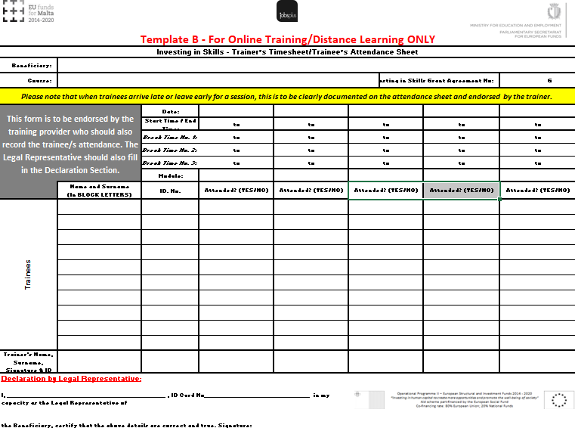
IIS Scheme: Documentation for Online/Distance Learning
Implementation Stage:
The training provider needs to confirm attendance and endorse each session
Notes:
After the training, and as part of the reimbursement process the training provider needs to confirm attendance and endorse each session – co signed by the employer legal representative.

Slide 34
IIS Scheme: Documentation for Online/Distance Learning
Reimbursement Stage:
Attendance Sheets (Template B) for Online/Distance Learning. In the case of online learning, screen shots of the ongoing training sessions are to be presented together with declaration/endorsement of legal representative and trainer including grant number, title of training, date, times and participants details. The declaration by the legal representative is incorporated in Template B.
Periodical screenshot of participants attending training. Such screenshots must be in line with the training schedule submitted prior commencement of training.

Slide 35
Contact Details:
Project Leader: Marthanne Castillo
marthanne.castillo@gov.mt
222 01 305
Generic Email: iis.jobsplus@gov.mt
Generic Phone No: 222 01 300
www.jobsplus.gov.mt
Notes:
You have our contacts. Please feel free to contact us. We will do out utmost to reply in the shortest time possible.

Slide 36
Q & A’s

